Slide 1
AJCSS Automatic Jobs Candidate Selection System
Supervisor
Professor Sultan S. Alqahtani
Team members:
Sultan Attaf Al-Salmi
Musaad Mubarak Alhammami
Abdulaziz Derham Asseri
Yasser Ahmed Almuhaidib
Auodh Mohmmed Al-Qahtani

Slide 2
TABLE OF CONTENTS
01
INTRODUCTION
02
METHODOLOGY
03
RESULTS
04
TEAM’S CONTRIBUTION
05
FUTURE WORK & CONCLUSION

Slide 3
INTRODUCTION

Slide 4
About Project
The project aims to simplify the process of recruiting applicants and job seekers, as well save time and cost for hiring department.

Slide 5
Motivation example
Traditional obsolete way
Automated modern way
Long interview procedure Short interview procedure
Manual candidates categorization Automated candidates categorization
01
02
03
04
Manual registration of applicant information Automated registration of applicant information
Search for matched candidates manually Search for matched candidates automatedly

Slide 6
Why project is important ?
Fast Speed up the process of job application
Precision Matching candidates precisely with job requirements
Simplicity Easy to use and simple to understand
Efficient Achieve maximum productivity with minimum wasted effort or expense

Slide 7
Objective & Goals
01
02
03
04
Automation Automation of the recruitment process
Simplification Simplify hiring process
Time Save recruitment time
Assistance Help to choose the right candidates

Slide 8
METHODOLOGY

Slide 9


Functional and Non-Functional Requirements
Matching
Save process
Addition/Deletion
Operational

Slide 10
Functional
Matching
The user selects a vacant job and match it with the unprocessed candidates to find the suitable ones for that job.

Slide 11
Functional
Save process
Save a new job or candidate / Update an existing job or candidate

Slide 12
Functional
Addition/Deletion
Add a new job or candidate / Delete an existing job or candidate

Slide 13
Non-Functional
Operational
The system must be easy and simple to use for the staff as well operate on Windows environment

Slide 14
Design phase
System level diagrams:
System’s interaction model (Use-case diagram)
System’s architectural pattern (pipe and filter pattern)
Detailed Design:
Activity chart
These are demonstrated in following slides.

Slide 15
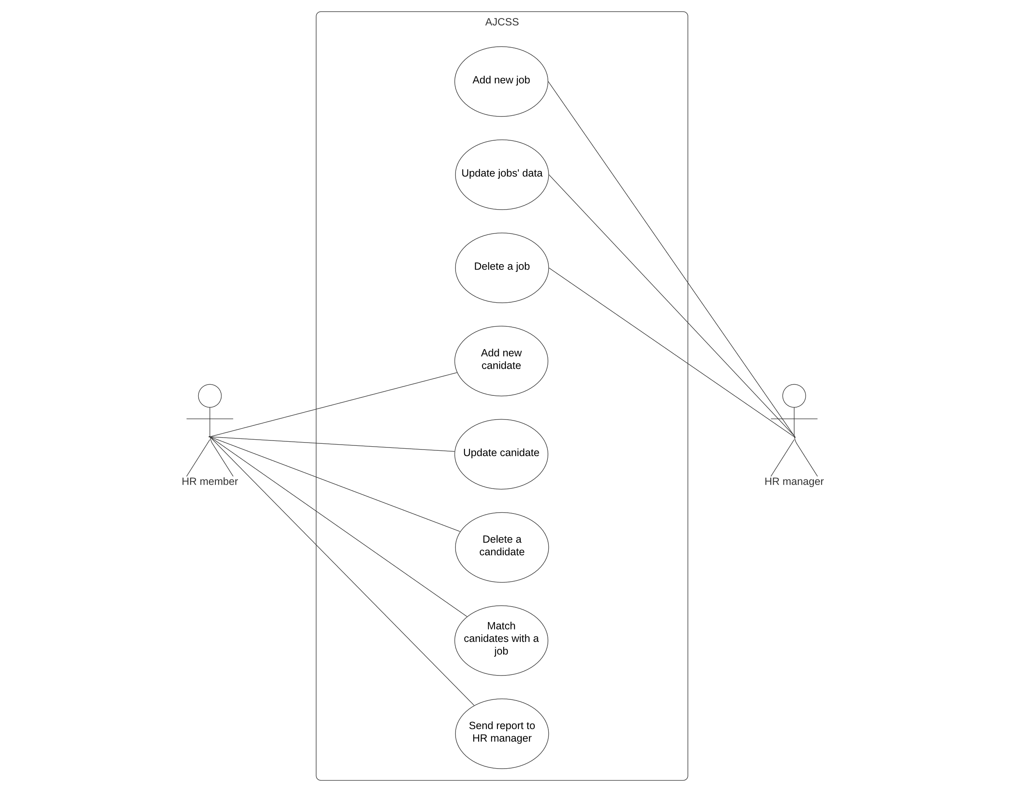
Use case diagram that depicts the use cases of HR manger and member actors

Slide 16
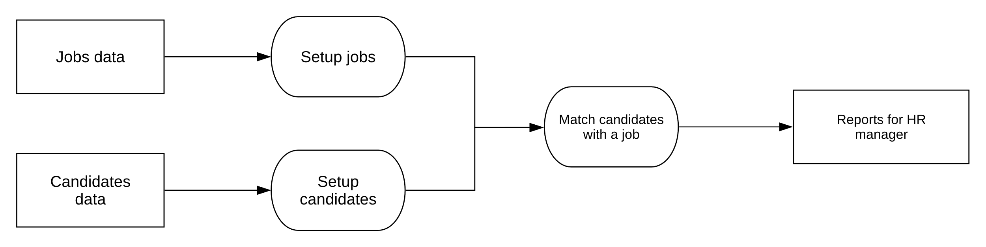
Pipe and filter pattern that depicts the data flow to the process of finding a match.

Slide 17
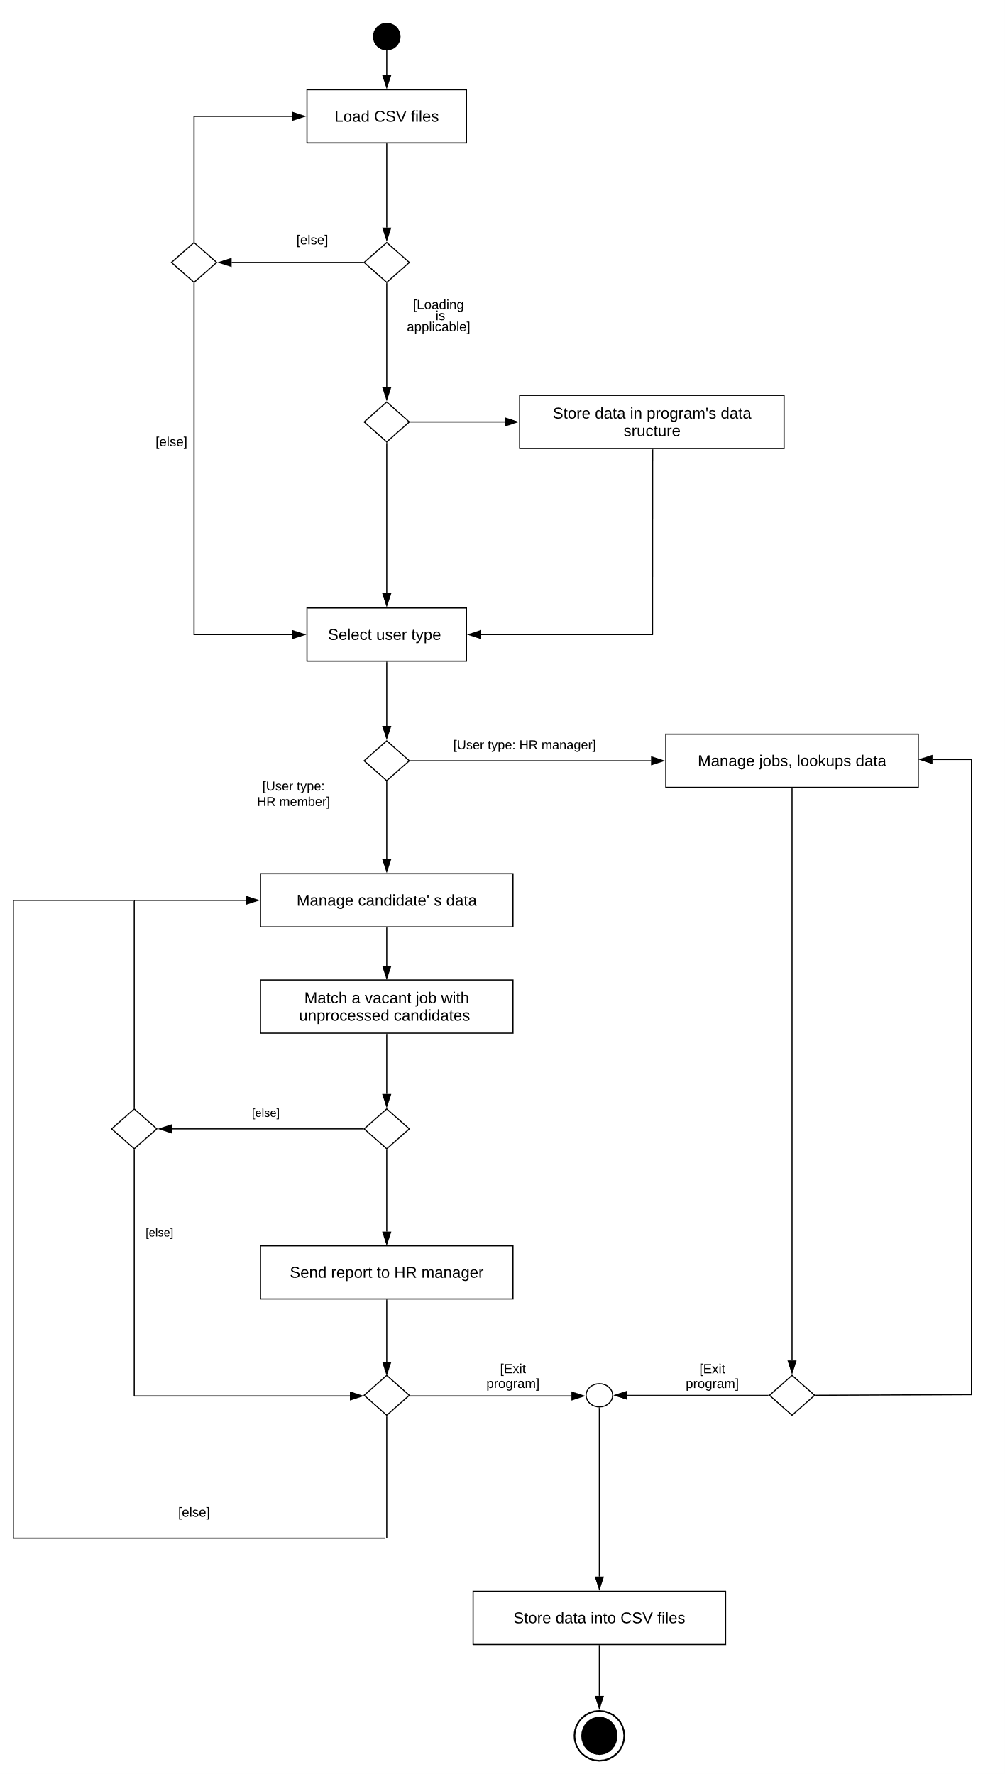
Activity chart of AJCSS that depicts the entire activity from start to end

Slide 18
Interface
This section contains screenshots of the functional requirements for the AJCSS user interface
Functional Requirements:
Matching (in Slide 19)
Addition (in Slide 20) / Deletion (in Slide 21)
Save process (in Slide 22)
These are demonstrated in following slides.

Slide 19
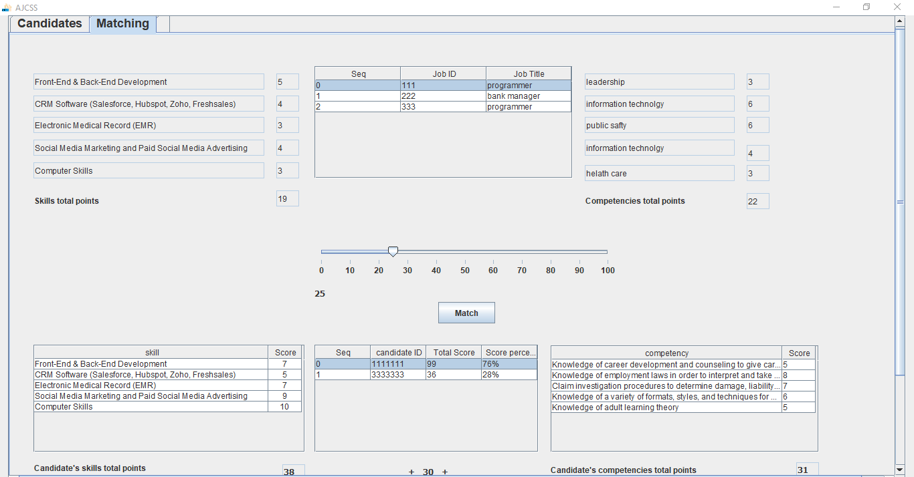
Matching

Slide 20
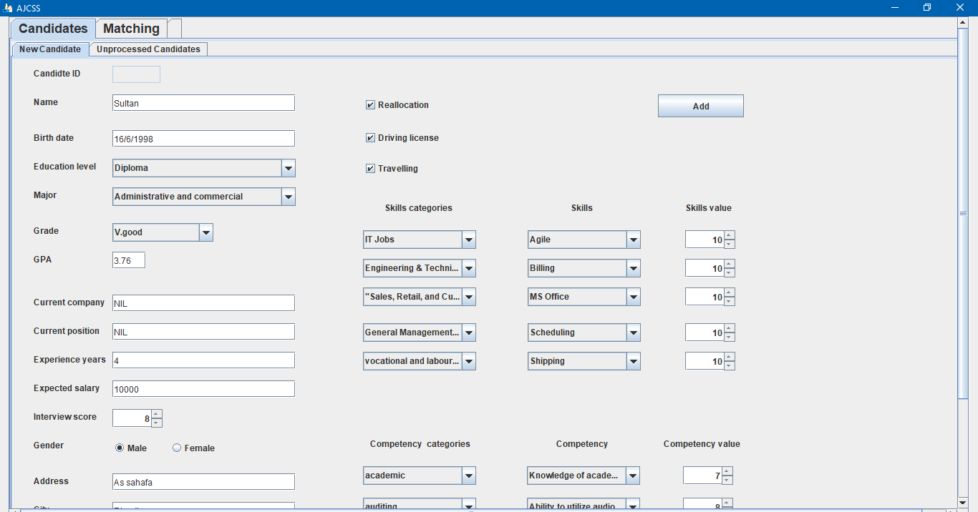
Addition

Slide 21
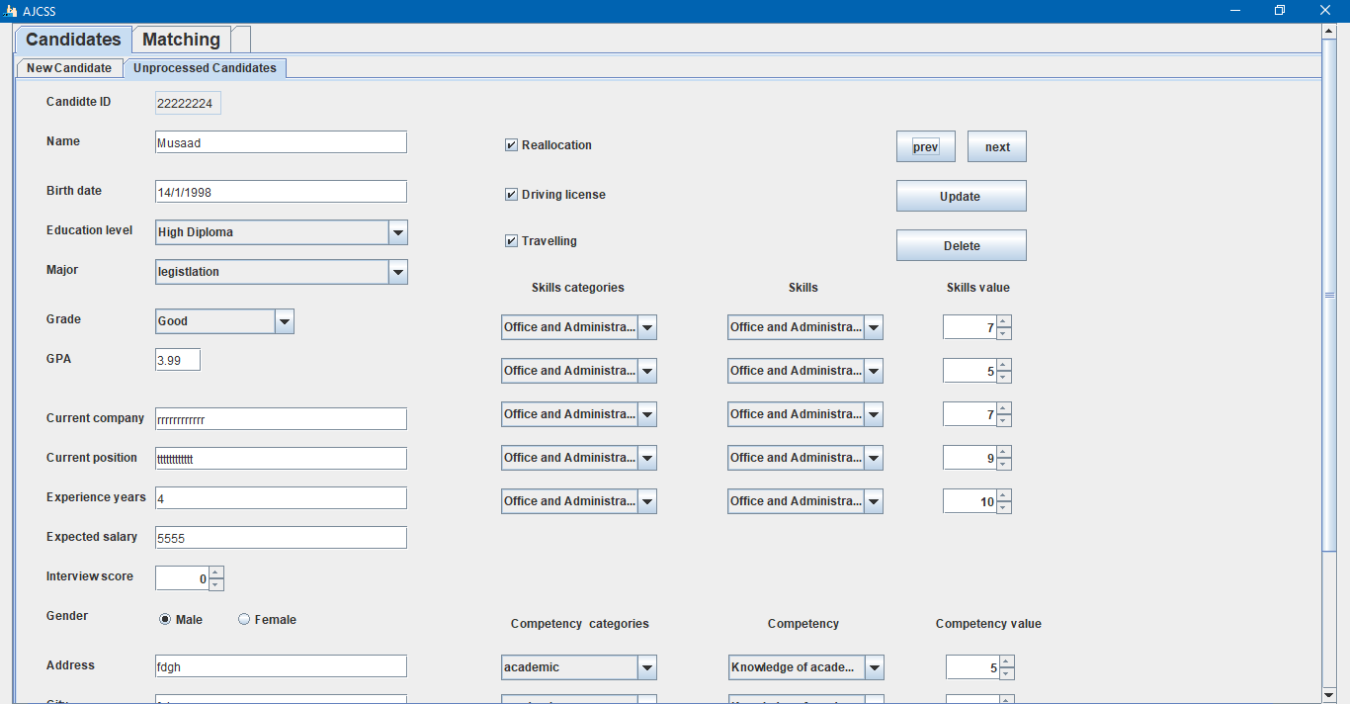
Deletion

Slide 22
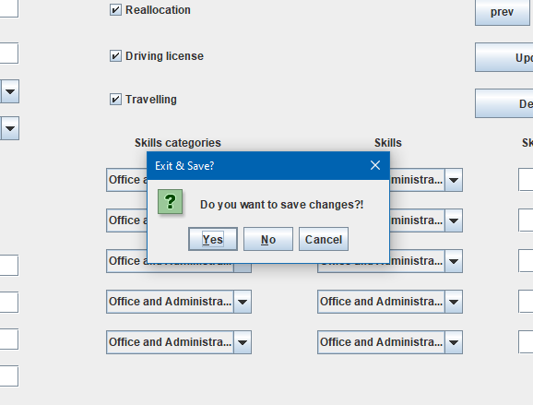
Save process

Slide 23
Source code
The functional requirements source code is too long. So, we will check it on GitHub.
https://github.com/iSultanz/AJCSS_Software/blob/master/Presentation%20FR%20Source%20Code/Souce%20Code.java

Slide 24
RESULTS

Slide 25
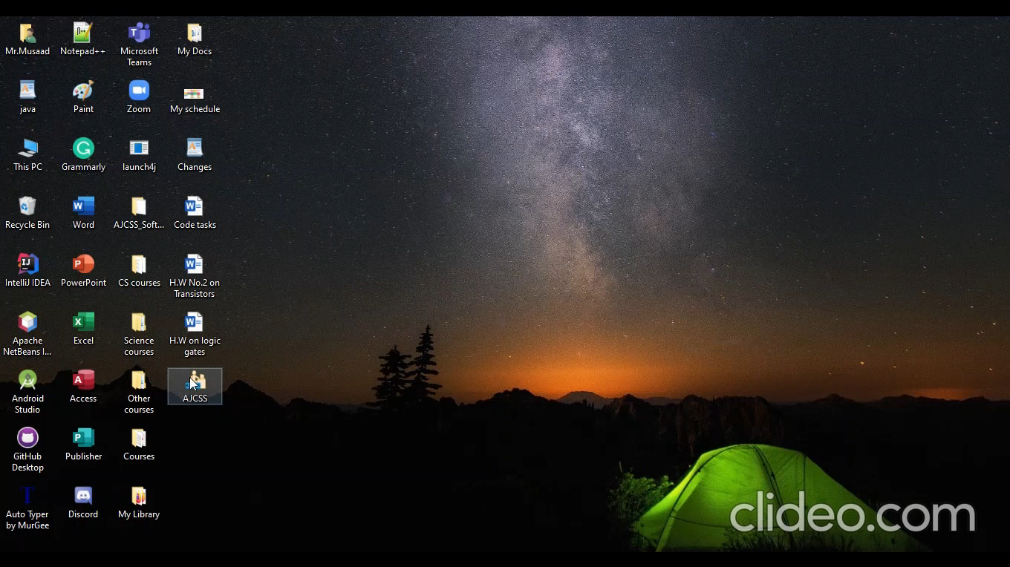
Implementation demo
Video showing the results of the software

Slide 26
TEAM’S CONTRIBUTION

Slide 27
Team’s Contribution
01
02
03
04
05
Sultan Coordinator of the group, documenter and designer
Abdulaziz Coder, implementer and tester
Musaad Coder, designer and tester
Yasser Designer, coder and documenter.
Auodh Documenter and coder
GitHub Repository: https://github.com/iSultanz/AJCSS_Software

Slide 28
FUTURE WORK AND CONCLUSION

Slide 29



Future work
Database implementation Implement and connect the software with database
Network implementation Implement the software with a network of devices
Online To keep the software up to date
Design Enhance the user interface design to be more sleek

Slide 30
Conclusion
In this presentation we gave an explanation of the system, goals to be achieved, how the system works, demonstrated the results and future work to be done.

Slide 31
THANKS! ANY QUESTIONS?

